Slide 1
The American Legion Post 22
A little about us

Slide 2
History of the American legion
The American Legion was chartered by Congress in 1919 as a patriotic veterans organization.
Focusing on service to veterans, servicemembers and communities
The Legion evolved from a group of war-weary veterans of World War I into one of the most influential nonprofit groups in the United States.
Membership swiftly grew to over 1 million, and local posts sprang up across the country.
Today, membership stands at over 2 million in more than 13,000 posts worldwide.
The posts are organized into 55 departments: one each for the 50 states, along with the District of Columbia, Puerto Rico, France, Mexico and the Philippines.
Over the years, the Legion has influenced considerable social change in America
won hundreds of benefits for veterans and produced many important programs for children and youth.

Slide 3
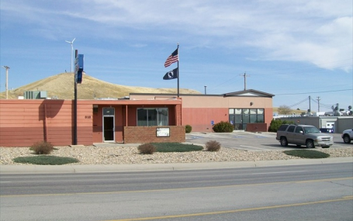
History of Post 22
Post 22 was chartered on July 14th, 1919.
We have over 600 members and are the 2nd largest Legion Post in South Dakota
Every member of this Post spent part of their lives as a member of the United States Armed Forces.
Each was/is willing to make the ultimate sacrifice for their country.
As members of The American Legion, our service to country and community continues.

Slide 4
Post 22 as an organization
This Post also has organizations within the organization.
American Legion Auxiliary: Wives/daughters/female family members of those who’ve served.
The Auxiliary administers hundreds of volunteer programs, gives tens of thousands of hours to its communities and to veterans, and raises millions of dollars to support its own programs.
Sons of The American Legion: Sons/nephews/male family members who haven’t served in the military.
Founded in 1932, Sons of The American Legion exists to honor the service and sacrifice of Legionnaires.

Slide 5
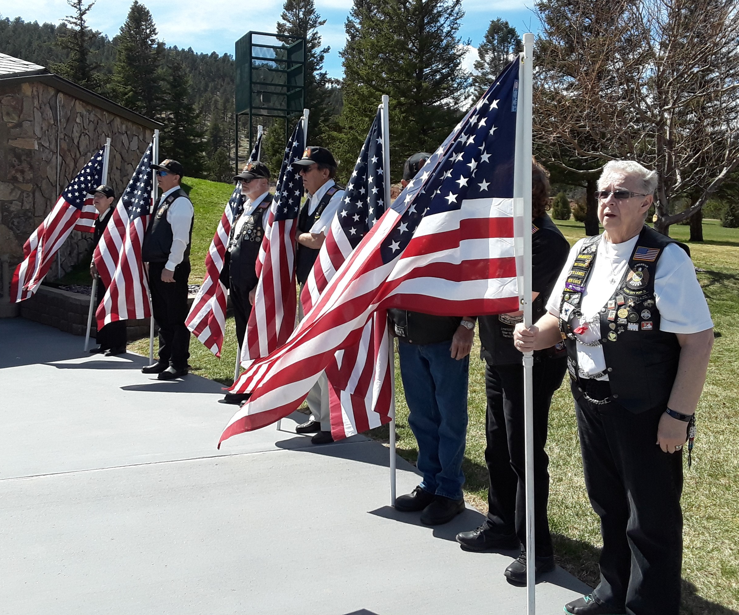
Post 22 Organizations
American Legion Riders:
Legionnaires and Auxiliary and SAL members joining to ride as Legion family.
Protect the sanctity of military funerals from protesters, and ensure no veteran dies alone.
Nationwide, the Riders have conducted massive cross-country fundraising events for wounded warriors from all services, and have raised millions of dollars for countless local, state and national charities.

Slide 6
What does the Legion Stand for?
The American Legion is founded on the Four Pillars of American Legion service:
Veterans
Programs, services and advocacy efforts that improve the lives of those who’ve served.
Defense
National defense, homeland security, border control and military support.
Americanism
Legion Baseball, Scouting, Boys State and Boys Nation
Youth
Strengthen the family unit, support organizations that help children in need.

Slide 7
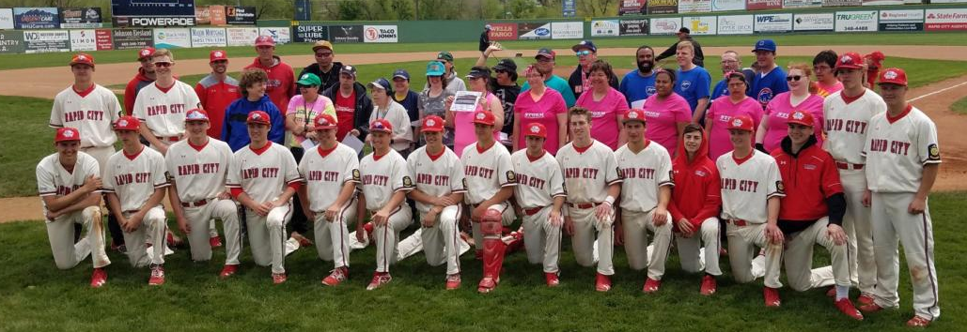
Americanism: Youth Programs
History:
American Legion youth programs began to take shape during the organization’s first two decades.
Support for Boy Scouts of America, passed by resolution in 1919.
American Legion Baseball was started in 1926 in Milbank South Dakota.
American Legion Boys State was founded in 1935 to counter a rising tide of subversive anti-American youth camps popping up across the country.
In 1938, the National High School Oratorical Contest debuted as an American Legion program to instill leadership and knowledge of the U.S. Constitution.

Slide 8
Post 22 Baseball
History:
While all ninety-one of South Dakota’s American Legion teams have loyal followings and rich histories, one of the strongest American Legion programs in the nation plays at the Floyd Fitzgerald Stadium in Rapid City.
Since their inception during WWI, the American Legion Post 22 Hardhats
Have won 41 state titles
Gone to eight American Legion World Series – including a win in 1993.

Slide 9
Post 22 Baseball
Significance for Post 22
This obvious rich and successful history has a profound effect on The American Legion Post 22.
Your efforts have helped put our Post on the map.
Full circle: We support and sponsor you, and your hard work, dedication and notoriety helps us.
Thank You and good luck on another incredible season of American Legion Baseball.

